Slide 1

Operation Hard Hat:
Protecting New York's Highway Workers
A Partnership Between NYS Department of Transportation, CSEA, Law Enforcement, and the Public
New York State Operation Hard Hat
2019–2026

Slide 2
Operation Hard Hat
Protecting Highway Workers Through Enforcement, Education, and Partnership
Presented by: Andrew Maroney
Organization: CSEA Local 1000
Date: June 22, 2026
Notes:
Today we'll discuss the history of Operation Hard Hat, how it began, the results it has achieved, and why strong partnerships between highway workers and law enforcement are critical to ensuring every worker returns home safely at the end of the day.

Slide 3
Why We Are Here
Every Worker Deserves to Go Home Safe
Highway workers face live traffic every day
Distracted and aggressive driving puts lives at risk
Work zones are workplaces
Safety is everyone's responsibility
Notes:
A construction zone is not an inconvenience—it is someone's workplace. Every worker in a hard hat is a parent, spouse, son, daughter, friend, or neighbor.

Slide 4
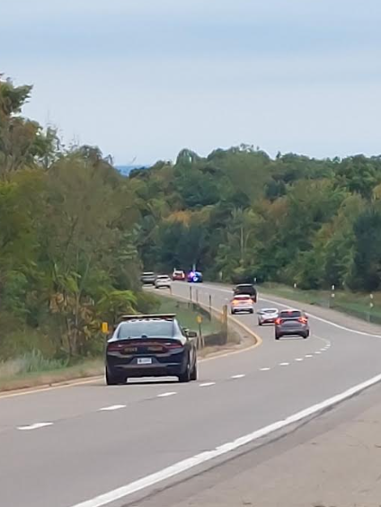
The Birth of Operation Hard Hat
Rochester, New York – 2019
Operation Hard Hat launched in the Rochester region in 2019
Partnership between:
  New York State Police
  NYSDOT
  CSEA
  Highway workers
Goal: Reduce dangerous driving in work zones
Troopers began working undercover inside work zones dressed as construction workers
Notes:
The innovative concept was simple: place troopers directly inside work zones where violations occur and identify drivers who put workers at risk.

Slide 5
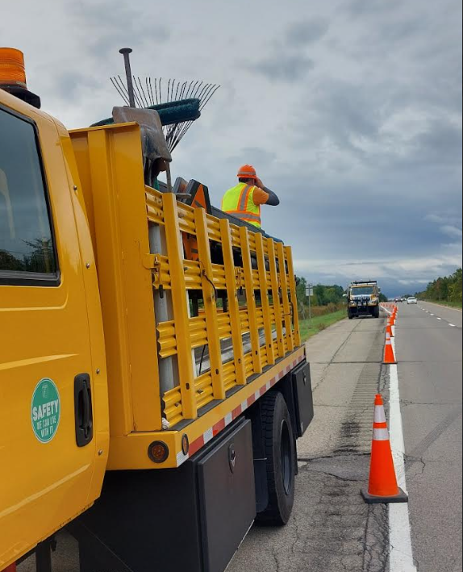
How Operation Hard Hat Works
A Unique Enforcement Strategy
Troopers dress as highway workers
Observe violations firsthand
Communicate with marked patrol units
Drivers are stopped immediately
Common violations:
Speeding
Distracted driving
Cell phone use
Move Over Law violations
Failure to obey flaggers

Slide 6
Why It Was Needed
The Reality Facing Highway Workers
Highway workers face:
Vehicles traveling at highway speeds
Distracted drivers
Work zone intrusions
Aggressive lane changes
Failure to move over
Notes:
Workers often operate only a few feet away from vehicles traveling 55–70 mph.

Slide 7
Building a Statewide Program
Expansion Across New York
Since 2019:
Expanded statewide
Involves multiple State Police troops
Includes local law enforcement participation
Conducted throughout construction season
Supported by labor organizations and contractors

Slide 8
Labor and Law Enforcement Working Together
A Shared Mission
Highway Workers + Law Enforcement = Safer Work Zones
Benefits:
Immediate enforcement
Increased worker confidence
Public awareness
Reduced dangerous behavior
Notes:
Operation Hard Hat demonstrates what can happen when labor and law enforcement work toward a common goal rather than separately.

Slide 9
The Human Side of Work Zones
Behind Every Hard Hat
Workers are:
Mothers
Fathers
Grandparents
Veterans
Coaches
Community members
The message is simple:
"Help Us Get Home"
This has become a central message in New York's work zone safety campaign.

Slide 10
2022 Results
Record Enforcement Activity
In 2022:
Operation Hard Hat issued a record 3,062 traffic violations
Up from 2,336 the previous year
Violations included:
Speeding
Distracted driving
Work zone offenses

Slide 11
Work Zone Dangers Continue
2024 Work Zone Statistics
New York State Thruway Work Zones:
156 crashes
1 fatality
30 injuries
Major causes:
Distracted driving
Following too closely
Unsafe lane changes
Ignoring warning signs

Slide 12
NYSDOT Work Zone Intrusions
A Serious Threat
In 2024:
322 work zone intrusions statewide
138 injuries to workers and motorists
2 driver fatalities involving work zone intrusions
Notes:
An intrusion occurs when a vehicle enters a protected work area. These incidents are among the most dangerous situations highway workers face.

Slide 13
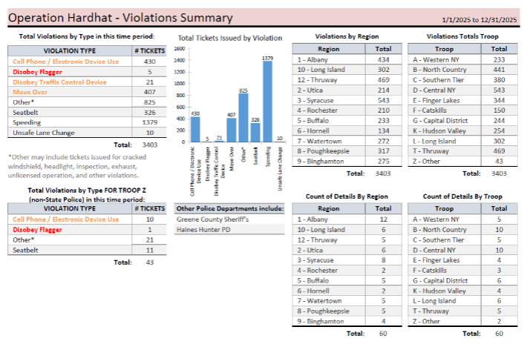
2025 Enforcement Results
Operation Hard Hat Success
During the 2025 construction season:
55 statewide enforcement operations
3,217 tickets issued
Violations targeted:
Speeding
Cell phone use
Seat belt violations
Move Over Law violations

Slide 14
Local Example: Southern Tier
Kirkwood Work Zone Enforcement
One Operation Hard Hat detail in 2025 issued:
69 tickets in approximately four hours
52 speeding tickets
11 cell phone violations
Move Over Law violations
One driver:
90 mph in a 55-mph work zone

Slide 15
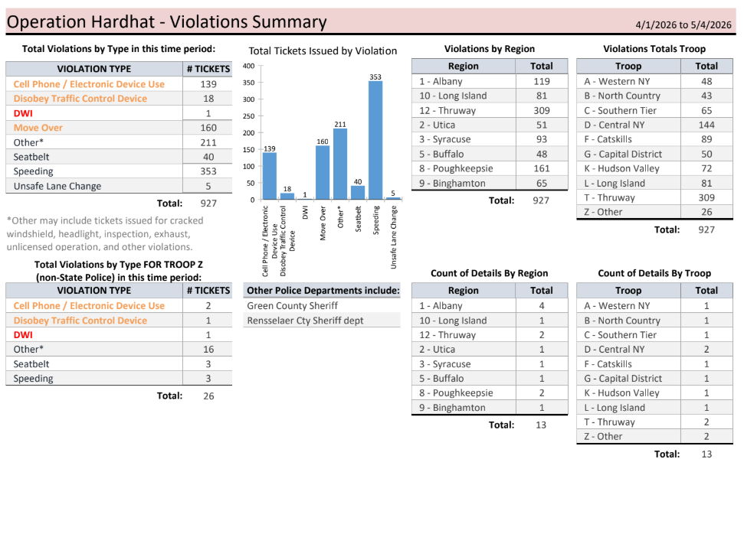
2026 National Work Zone Awareness Week
Strong Enforcement Continues
April 2026:
12 enforcement details statewide
967 tickets issued in five days
35% increase over 2025 awareness week enforcement

Slide 16
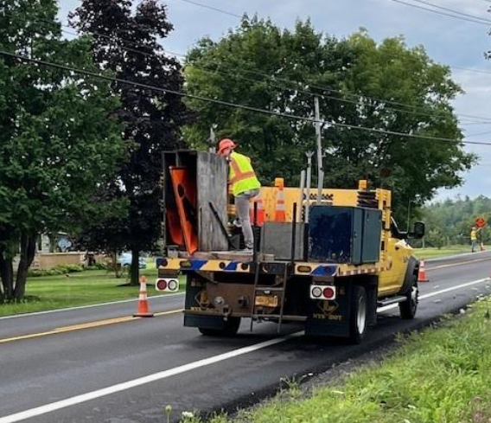
Breakdown of 2026 Violations
What Troopers Found
Among 967 tickets:
401 speeding violations
160 Move Over Law violations
138 distracted driving violations
214 other traffic violations

Slide 17
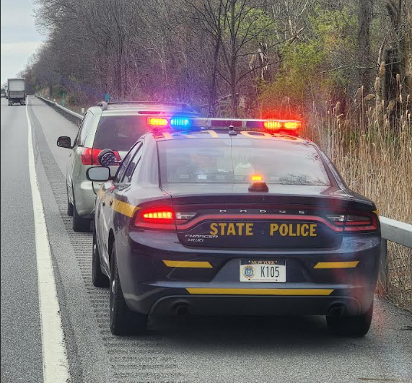
Why Enforcement Matters
Changing Driver Behavior
Enforcement:
Raises awareness through
visibly and media announcements
Reduces speeding
Encourages compliance
Protects workers
Saves lives
Notes:
The goal is not simply issuing tickets. The goal is preventing injuries and fatalities.

Slide 18
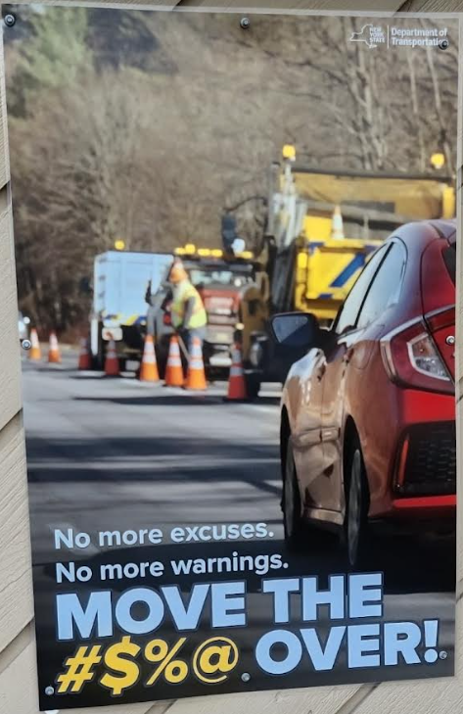
Respect the Zone So We All Get Home
National Work Zone Awareness Message
Recent campaign themes:
"Respect the Zone
so We All Get Home“
"Safe Actions Save Lives“
"Help Us Get Home“
And my favorite of all –

Slide 19
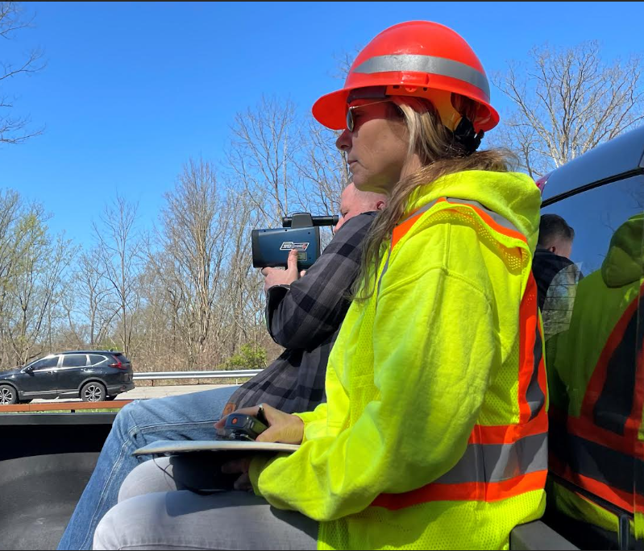
The Importance of Relationships between Highway Workers and Law Enforcement
Working Together for Safety
Strong partnerships provide:
Better communication
Shared safety goals
Mutual trust
Greater public impact
Safer work zones
Notes:
When workers and law enforcement collaborate, everyone benefits—including the traveling public.

Slide 20
What Drivers Need to Remember
Five Life-Saving Actions
Slow down
Stay alert
Put the phone away
Move over when required
Follow flaggers and signs

Slide 21
Looking Forward
The Future of Work Zone Safety
Continued focus on:
Operation Hard Hat
Automated Work Zone Speed Enforcement
Public education
Strong labor-police partnerships
Worker safety initiatives

Slide 22
Final Message
Every Worker Has Someone Waiting at Home
Highway workers:
Build our roads
Maintain our infrastructure
Respond during emergencies
They deserve:
Respect
Protection
Safe working conditions
Every worker deserves to go home safely at the end of the day.

Slide 23
Questions
Thank You
Operation Hard Hat
Protecting Those Who Protect Our Highways
"Safe Actions Save Lives."

